Slide 1

Introduction
HTML (Hypertext Markup Language) is a language used to create the structure and content of websites. It is the foundation upon which all websites are built, and every web developer must have a good understanding of HTML to create dynamic and engaging web pages.
    HTML stands for Hyper Text Markup Language
    HTML was invented by Tim Berners-Lee in 1991.
    HTML is used for creating web pages and web applications.
    It is used to describe the structure of Web pages using markup tags.

Slide 2
Fundamental of HTML Tags
HTML is written in the form of HTML elements consisting of markup tags. These markup tags are the fundamental characteristic of HTML. Every markup tag is composed of a keyword, surrounded by angle brackets <tagname>content</tagname>.
Standalone tags
Container tags
    HTML tags normally come in pairs like <p> and </p>
    The first tag in a pair is the start tag, the second tag is the end tag.
    The end tag is written like the start tag, but with a slash before the tag name.

Slide 3
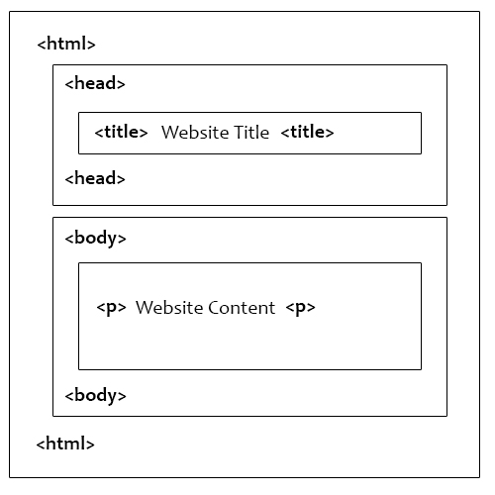
Basic Structure of HTML

Slide 4
HTML Headings Tags
<h1>Heading Level 1</h1>
<h2>Heading Level 2</h2>
<h3>Heading Level 3</h3>
<h4>Heading Level 4</h4>
<h5>Heading Level 5</h5>
<h6>Heading Level 6</h6>
Horizontal Ruler in HTML
<hr align="center" width="70%" size="3" color="#8080ff">
HTML Comment Tag
<!-- Write your comments here -->

Slide 5
Text Formatting in HTML
<p> | <strong> | <em> | <u> | <sup>
<sub> | <mark> | <del> | <ins> | <small>
<br> | <hr> | <blockquote> | <q> | <pre>
<i> | <b> | <address> | <center> | <abbr>

Slide 6
HTML Images
<img src="flower.jpg">
<img src="images/flower.jpg" alt="Flower">
<img src="images/flower.jpg" alt="Flower" height="250px" width="400px" border="1" >
HTML Div Element
<div>
<h2>London</h2>
<p>London is the capital city of England.</p>
<p>London has over 13 million inhabitants.</p>
</div>

Slide 7
Table Tag
<table> | <tr> | <th> | <td> | <thead>
 |  |  |  | <caption>
colspan :is used to specify how many columns a cell should span horizontally
rowspan : is used to specify how many columns a cell should span vertically

Slide 8
Creating Lists in HTML
Unordered List: <ul>...</ul> - Represents a list of items with bullet
      Disc (default)
      circle
      square
Ordered List: <ol>...</ol> - Represents a list of items with numbers
      1(default)
      I
      i
      A
      a
Definition List: <dl>...</dl> - Represents a list of terms and their associated descriptions

Slide 9
Marquee Tag in HTML
The <marquee> </marquee> tag in HTML is used to create a scrolling text or an image.
direction: Specifies the direction of the scrolling content. The values can be left, right, up, or down .
behavior: Specifies the scrolling behavior. The values can be scroll, slide, or alternate .
bgcolor: Specifies the background color of the scrolling content.
height and width: Specifies the height and width of the scrolling content.
scrollamount: Specifies the speed of the scrolling content.
loop: Specifies the scrolling content moving count.

Slide 10
Creating Hyperlinks with the Anchor Tag in HTML
In HTML, the anchor tag (<a>) is used to create hyperlinks. Hyperlinks are links that allow users to navigate to other pages or sections within a website. The anchor tag is one of the most important tags in HTML as it is used to create links between different web pages.
<a href="v2.jpg"> Lists</a>

Slide 11
Form Elements in HTML
The <input> Element
<input type="button">
<input type="checkbox">
<input type=“text">
<input type="color">
<input type="date">
<input type="datetime-local">
<input type="email">
<input type="file">
<input type="image">
<input type="month">
<input type="number">
<input type="password">
<input type="radio">
<input type="range">
<input type="reset">
<input type="search">
<input type="submit">
<input type="tel">
<input type="text">
<input type="time">
<input type="url">
<input type="week">
<form>
form elements
</form>
<input>
<label>
<select>
<textarea>
<button>
<fieldset>
<legend>
<option>

Slide 12
HTML Input Attributes
<input type="text" id="fname" name="fname" value="John">
<input type="text" id="fname" name="fname" value="John" readonly>
<input type="text" id="fname" name="fname" value="John" disabled>
<input type="text" id="fname" name="fname" size="50">
<input type="text" id="pin" name="pin" maxlength="4" size="4">
<input type="number" id="quantity" name="quantity" min="1" max="5">
<input type="file" id="files" name="files" multiple>

Slide 13
<input type="text" id="country_code" name="country_code“ pattern="[A-Za-z]{3}" title="Three letter country code">
<input type="tel" id="phone" name="phone“ placeholder="123-45-678“>
<input type="text" id="username" name="username" required>
<input type="text" id="fname" name="fname" autofocus>
<input type="image" src="img_submit.gif" alt="Submit" width="48" height="48">
<input type="email" id="email" name="email" autocomplete="off">

Slide 14
iframe
Frames in HTML are a way to divide a web page into multiple sections, each displaying its own separate HTML document. Each of these sections (or "frames") can scroll independently and have its own individual URL.
<iframe src="list_tag.html" width="500" height="400"></iframe>
frameset
The frameset element in HTML is used to define a set of frames on a web page. It allows you to divide a single HTML document into multiple, independent sections that can be independently scrolled, or navigated to a different page.

Slide 15
The HTML <audio> Element
<audio controls>
<audio controls autoplay>
<audio controls autoplay muted>
<source src="horse.mp3" type="audio/mpeg">
</audio>
The HTML <video> Element
<video width="320" height="240" autoplay muted>
<source src="movie.mp4" type="video/mp4">
</video>

